Slide 1

PORTABLE ULTRASONIC RANGE METER USING PROTEUS
PROJECT 3 : Electronic Circuit

Slide 2



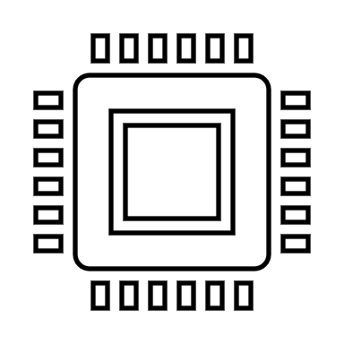
Presented by
Muhamad Farhan Budiana
Gafrilatif Aviandi Putra Adnanta
Muhammad Zidan Satrio

Slide 3
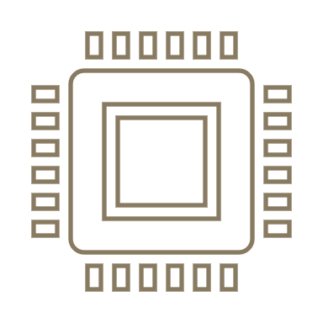
CONTENTS
GROUP 4 MEMBERS
1
GROUP 4 MEMBERS
2
SYSTEM ANALYSIS
3
SCHEMATIC VIEW
4
COMPONENTS
5
RESULT OF ANALYSIS

Slide 4
SYSTEM ANALYSIS
In this Project we are using Proteus Software, Proteus 8 Professional is an electronic software that is used to assist designers in designing and simulating electronic circuits.
Ultrasonic Range Meter is designed which can be used to measure distance of a target in non-contact fashion. The project is based on Arduino, Ultrasonic Sensor and an LCD display.

Slide 5
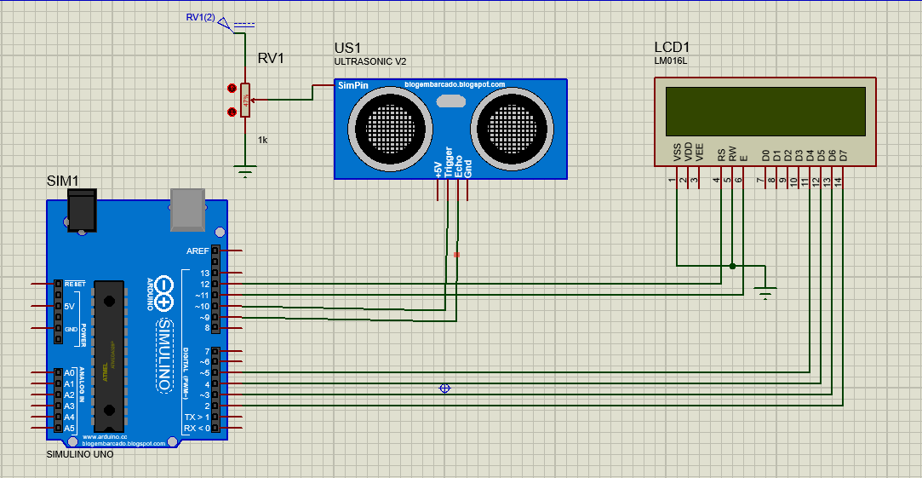
SCHEMATIC VIEW

Slide 6
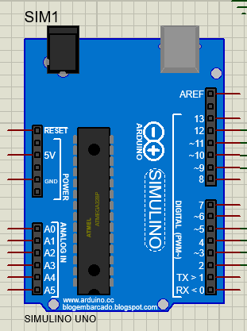
COMPONENTS : Arduino Uno
is a type of microcontroller board based on the ATmega328, and Uno is an Italian term which means one. Arduino Uno was chosen for the upcoming launch of the microcontroller board namely Arduino Uno Board 1.0.

Slide 7
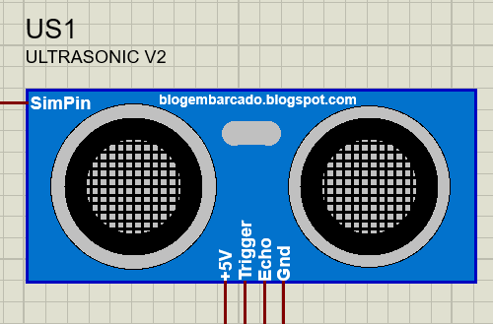
COMPONENTS : Ultrasonic Sensor
An ultrasonic sensor is an instrument that measures the distance to an object using ultrasonic sound waves.

Slide 8
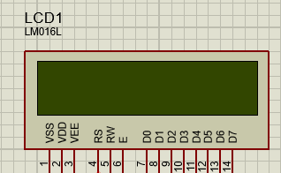
COMPONENTS : LCD Screen
LCD (Liquid Crystal Display) is a type of flat panel display which uses liquid crystals in its primary form of operation.

Slide 9
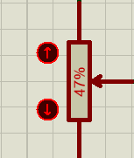
COMPONENTS : POT - HG
Potentiometer (POT) is a type of resistor whose resistance value can be adjusted according to the needs of the electronic circuit or the needs of the user.

Slide 10
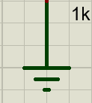
COMPONENTS : GROUND
Grounding in electronics is different from the earth connection in wall outlets (although they sometimes are connected).

Slide 11
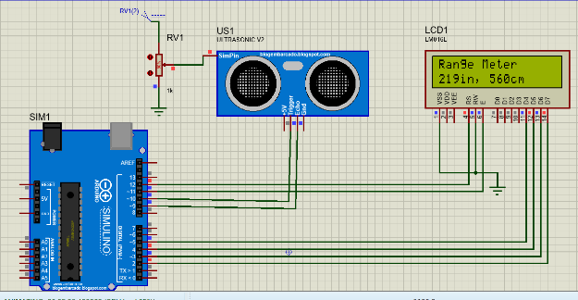
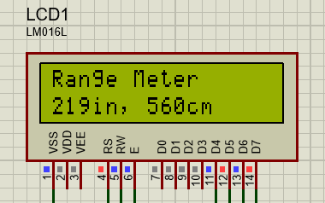
RESULT OF ANALYSIS
Based on the results obtained, it can be concluded that the author has managed to make ultrasonic range meter using arduino and proteus. This system is used to measure distance of a target in non-contact fashion. The project is based on Arduino, Ultrasonic Sensor and an LCD display.

Slide 12
THANK YOU
FOR YOUR ATTENTION

